Slide 1


Machine Learning for Neuroscience
Variational Autoencoders
Payam Barnaghi
Department of Brain Sciences
Imperial College London
Spring 2023
The main content are adapted from: Ch. 17, Understanding Deep Learning, Simon J.D. Prince, MIT Press.
Notes:
1

Slide 2
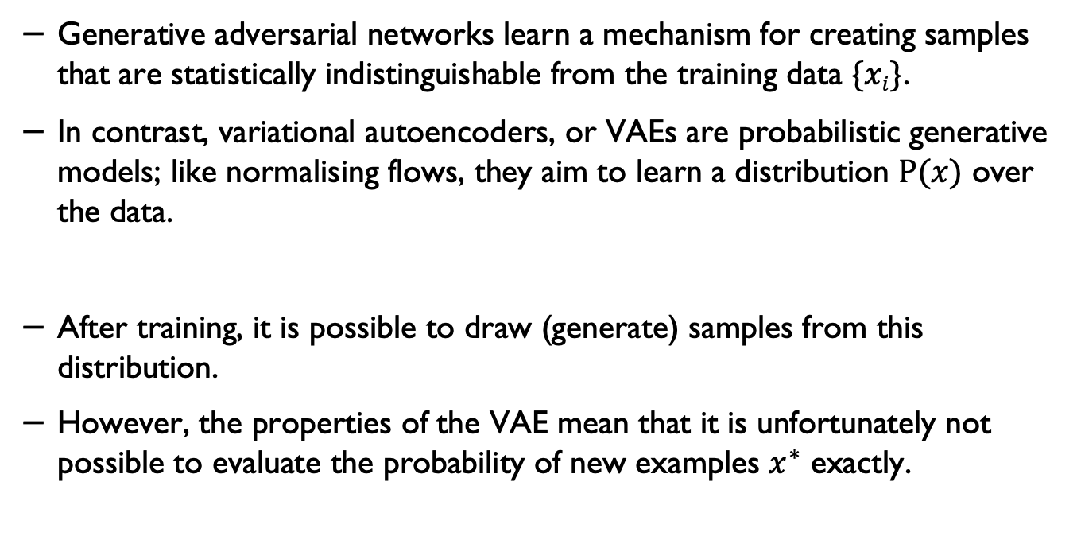
Variational models
Generative adversarial networks learn a mechanism for creating samples that are statistically indistinguishable from the training data $\{xi\}$.
In contrast, variational autoencoders, or VAEs are probabilistic generative models; like normalising flows, they aim to learn a distribution $P(x)$ over the data.
After training, it is possible to draw (generate) samples from this distribution.
However, the properties of the VAE mean that it is unfortunately not possible to evaluate the probability of new examples $x^{∗}$ exactly.
Understanding Deep Learning, Simon J.D. Prince, MIT Press.

Slide 3
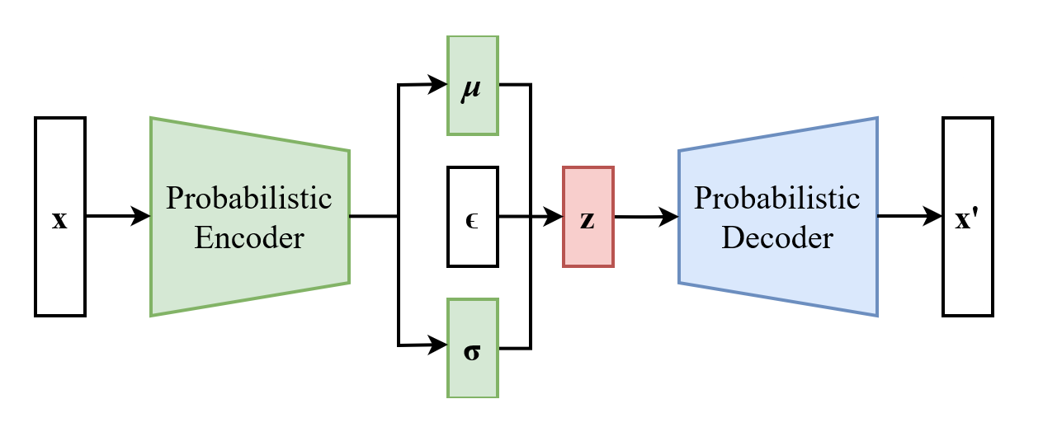
Variational autoencoder
Image credit: Wikipedia

Slide 4
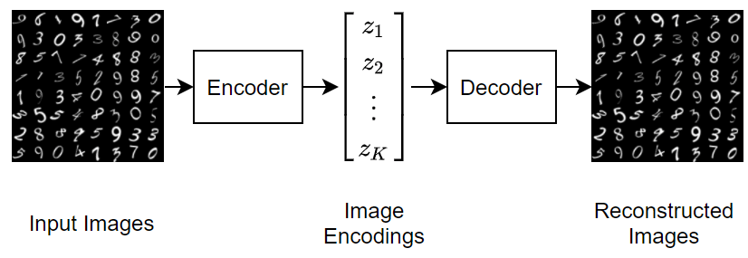
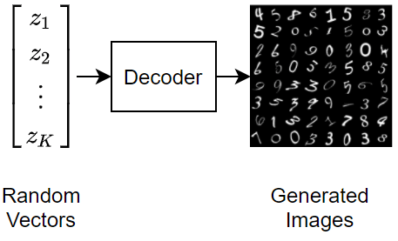
Variational autoencoder
Image credit: mathworks.com

Slide 5
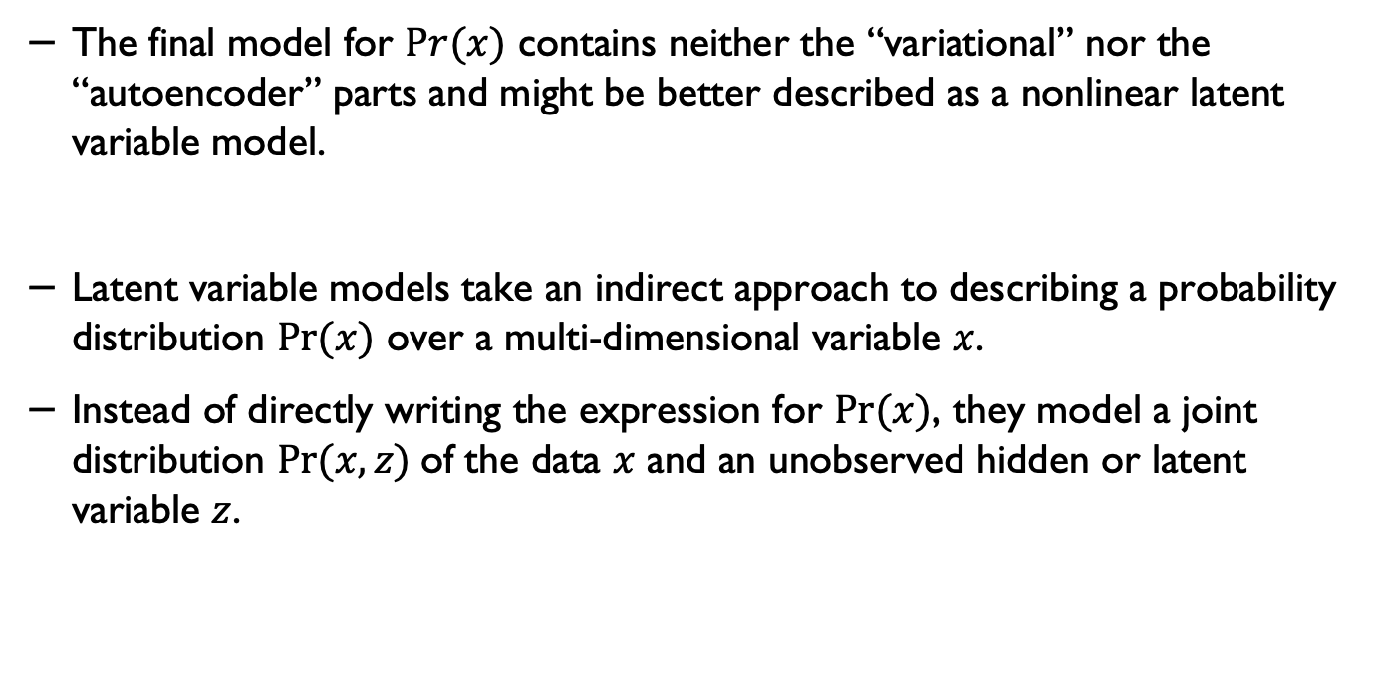
Latent variable model
The final model for $Pr(x)$ contains neither the “variational” nor the “autoencoder” parts and might be better described as a nonlinear latent variable model.
Latent variable models take an indirect approach to describing a probability distribution $Pr⁡(x)$ over a multi-dimensional variable $x$.
Instead of directly writing the expression for $Pr⁡(x)$, they model a joint distribution $Pr⁡(x, z)$of the data $x$ and an unobserved hidden or latent variable $z$.

Slide 6
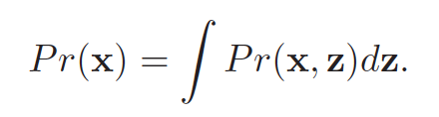
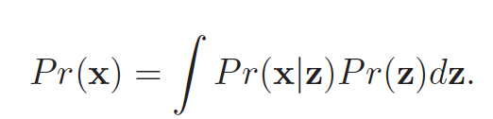
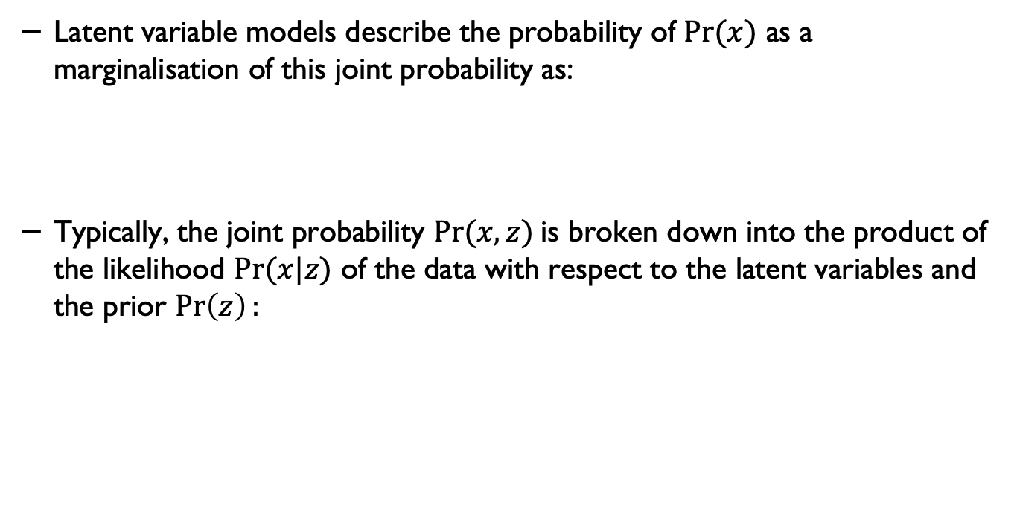
Latent variable models
Latent variable models describe the probability of $Pr⁡(x)$ as a marginalisation of this joint probability as:
Typically, the joint probability $Pr⁡(x, z)$is broken down into the product of the likelihood $Pr⁡(x|z)$ of the data with respect to the latent variables and the prior $\operatorname{Pr}\left(z\right):$
Understanding Deep Learning, Simon J.D. Prince, MIT Press.

Slide 7
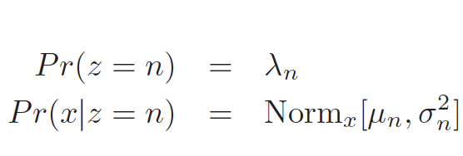
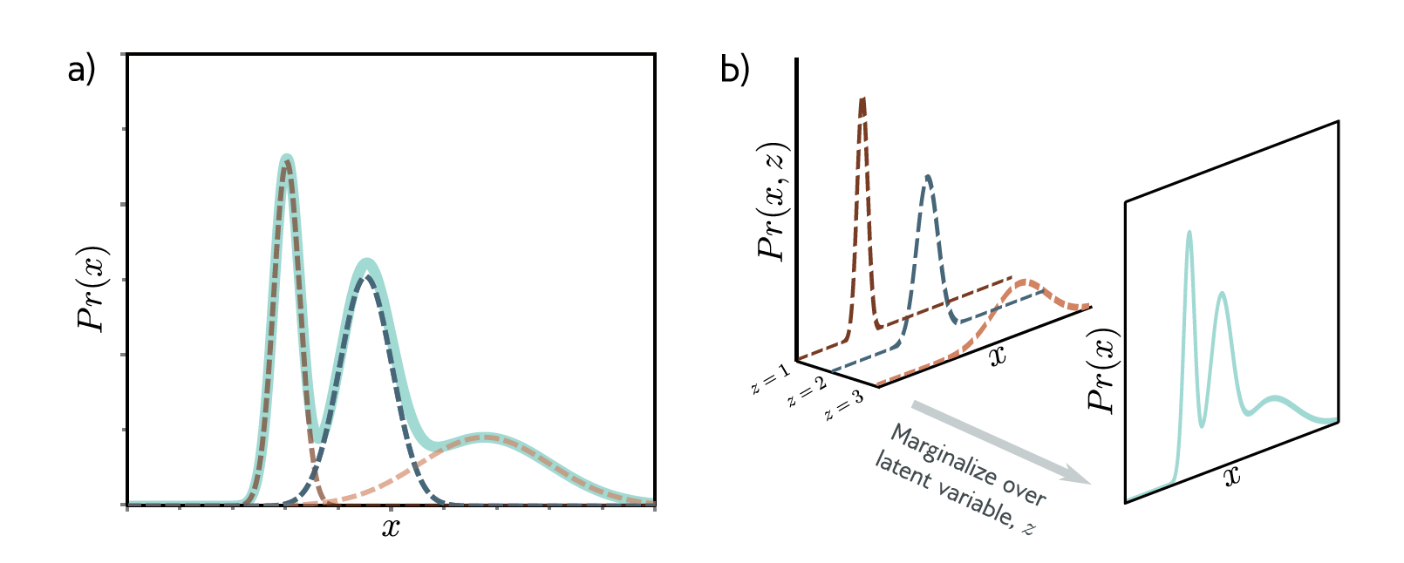
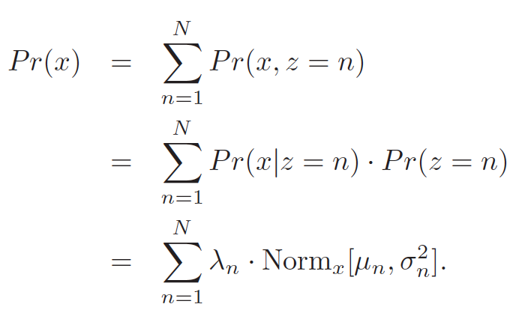
Example: mixture of Gaussians
Understanding Deep Learning, Simon J.D. Prince, MIT Press.

Slide 8
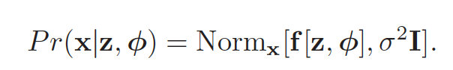
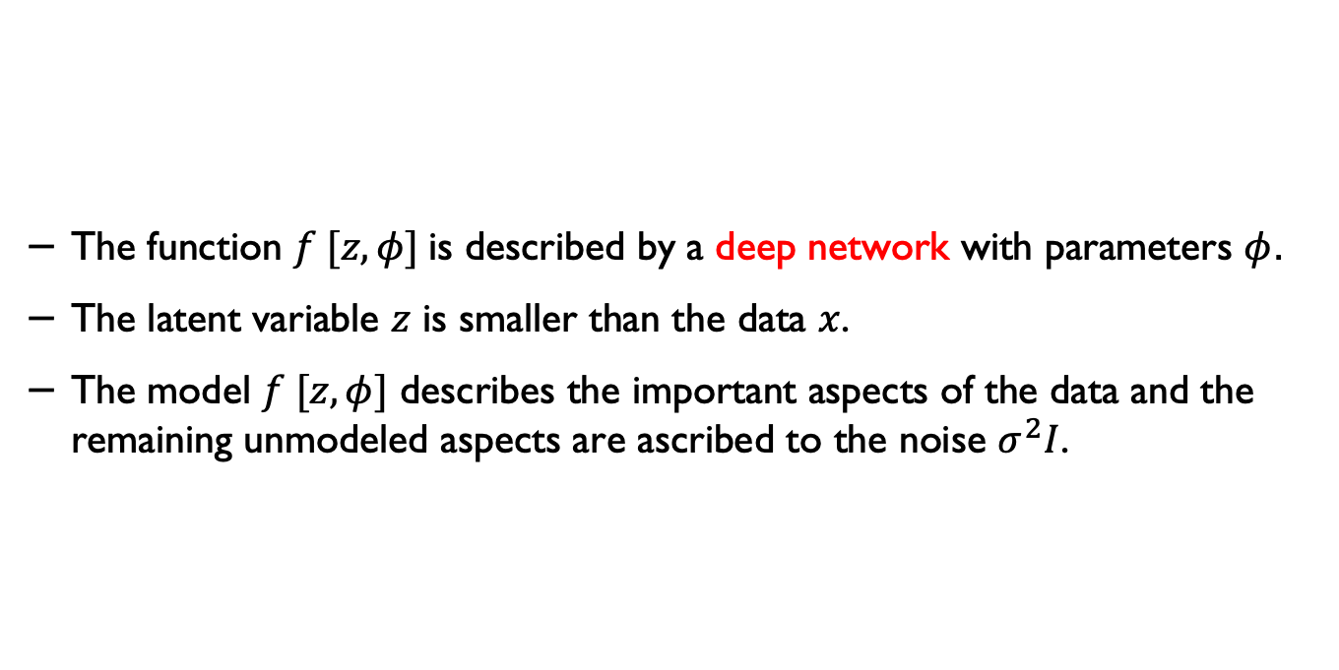
Nonlinear latent variable model
The function $f [z,φ]$is described by a deep network with parameters $φ$.
The latent variable $z$ is smaller than the data $x$.
The model $f [z,φ]$ describes the important aspects of the data and the remaining unmodeled aspects are ascribed to the noise $σ^{2}I$.
Understanding Deep Learning, Simon J.D. Prince, MIT Press.

Slide 9
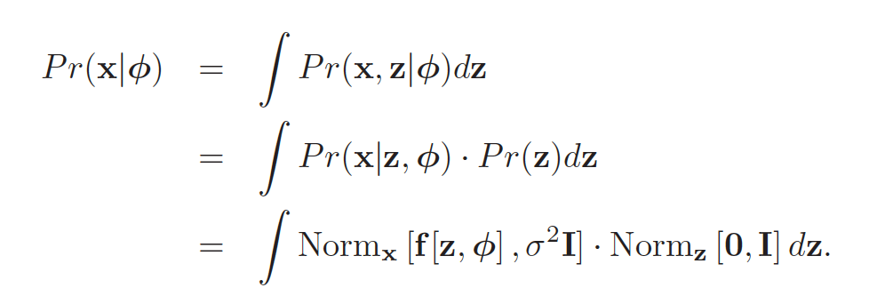
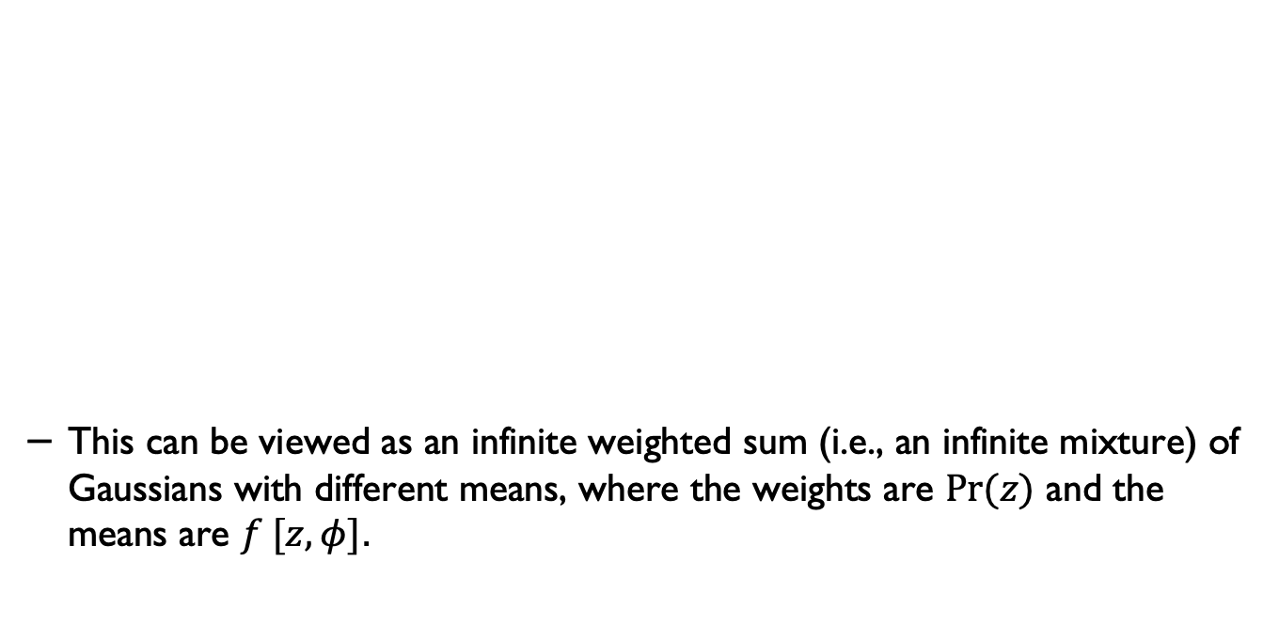
Nonlinear latent variable model
This can be viewed as an infinite weighted sum (i.e., an infinite mixture) of Gaussians with different means, where the weights are $Pr⁡(z)$ and the means are $f [z,φ]$.
Understanding Deep Learning, Simon J.D. Prince, MIT Press.

Slide 10
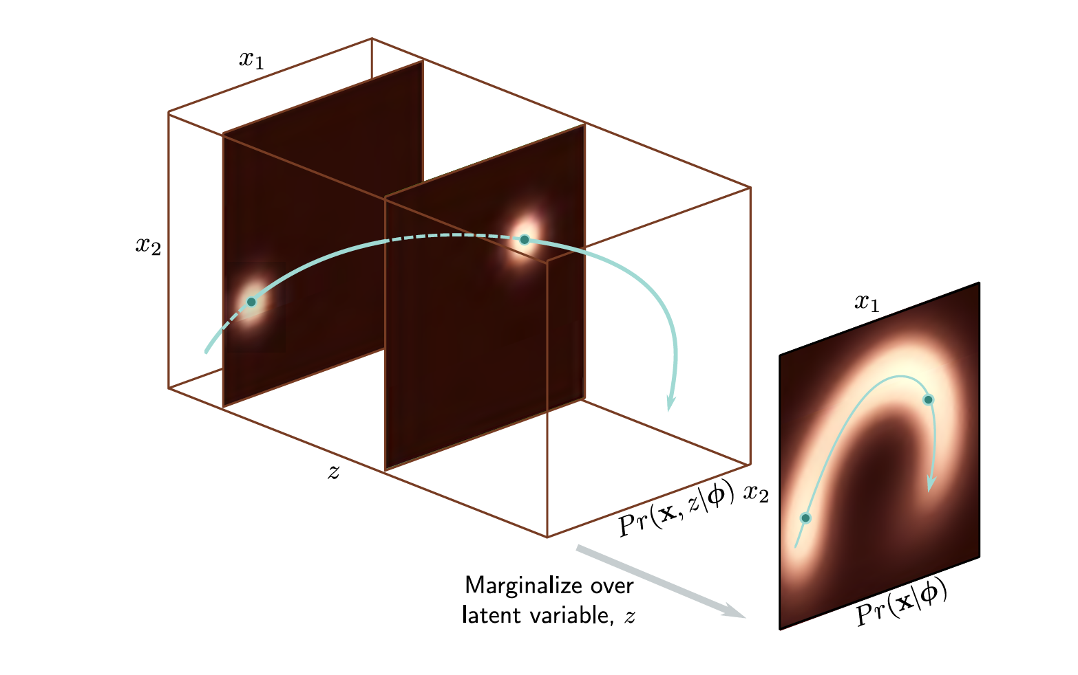
Nonlinear latent variable model
Understanding Deep Learning, Simon J.D. Prince, MIT Press.

Slide 11
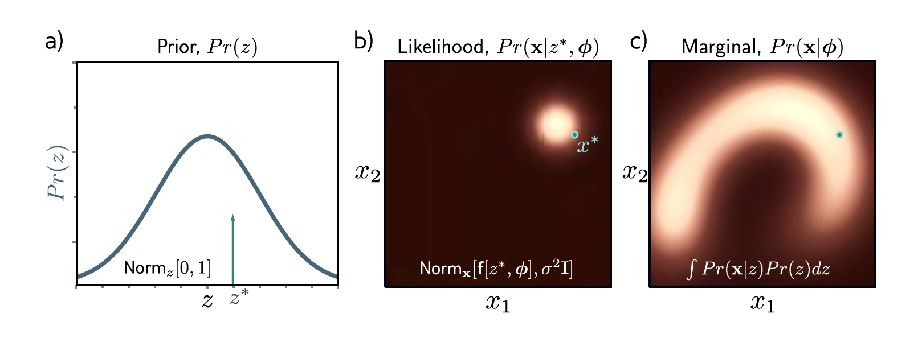
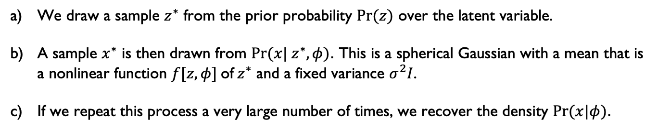
Generation from nonlinear latent variable model
We draw a sample $z^{∗}$ from the prior probability $Pr⁡(z)$ over the latent variable.
A sample $x^{∗}$ is then drawn from $Pr⁡(x| z^{∗},φ)$. This is a spherical Gaussian with a mean that is a nonlinear function $f[z,φ]$of${ z}^{∗}$ and a fixed variance $σ^{2}I$.
If we repeat this process a very large number of times, we recover the density $Pr⁡(x|φ)$.
Understanding Deep Learning, Simon J.D. Prince, MIT Press.

Slide 12
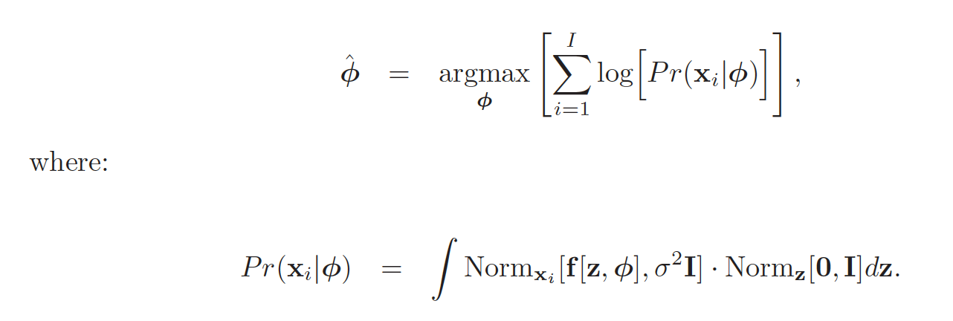
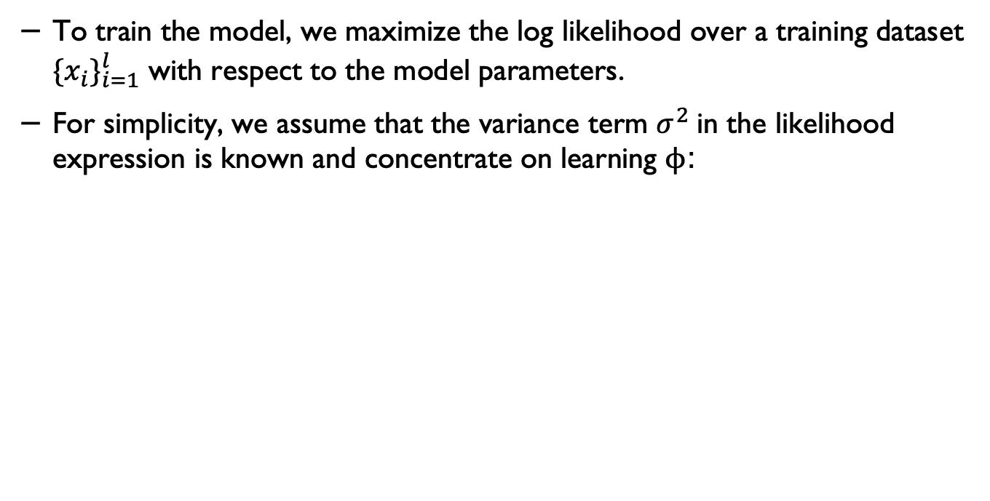
Training
To train the model, we maximize the log likelihood over a training dataset ${\{x_{i}\}}_{i=1}^{l}$ with respect to the model parameters.
For simplicity, we assume that the variance term $σ^{2}$in the likelihood expression is known and concentrate on learning ϕ:
Understanding Deep Learning, Simon J.D. Prince, MIT Press.

Slide 13
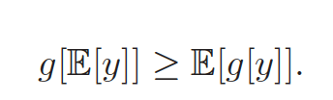
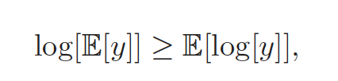
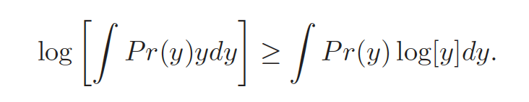
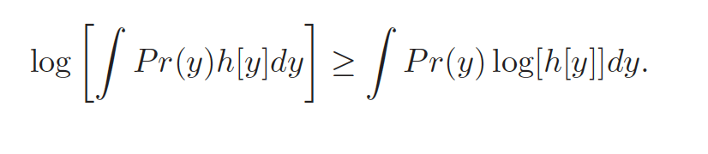
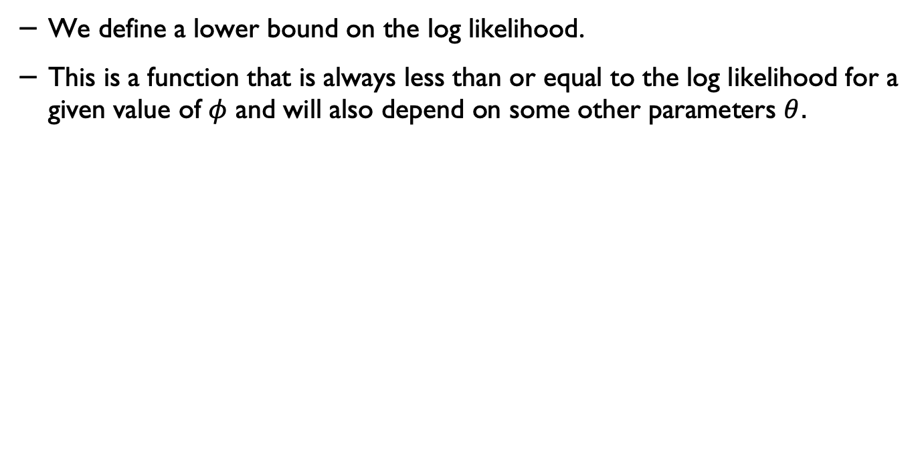
Evidence lower bound (ELBO)*
We define a lower bound on the log likelihood.
This is a function that is always less than or equal to the log likelihood for a given value of $φ$ and will also depend on some other parameters $θ$.
(Jensen’s inequality)
Understanding Deep Learning, Simon J.D. Prince, MIT Press.

Slide 14
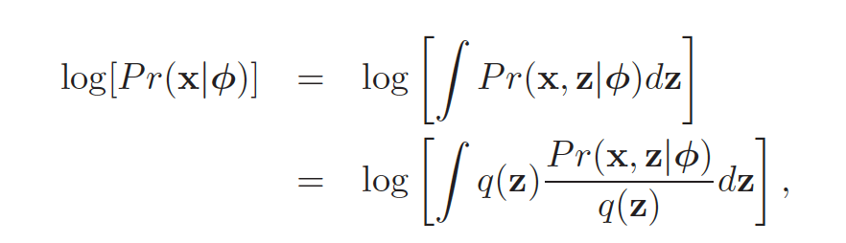
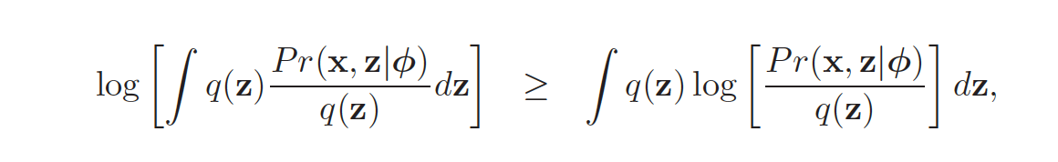
Deriving the ELBO*

Slide 15
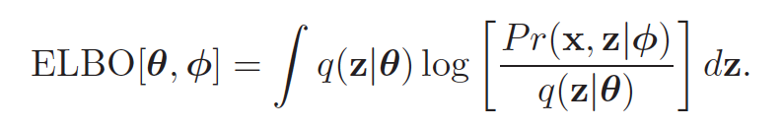
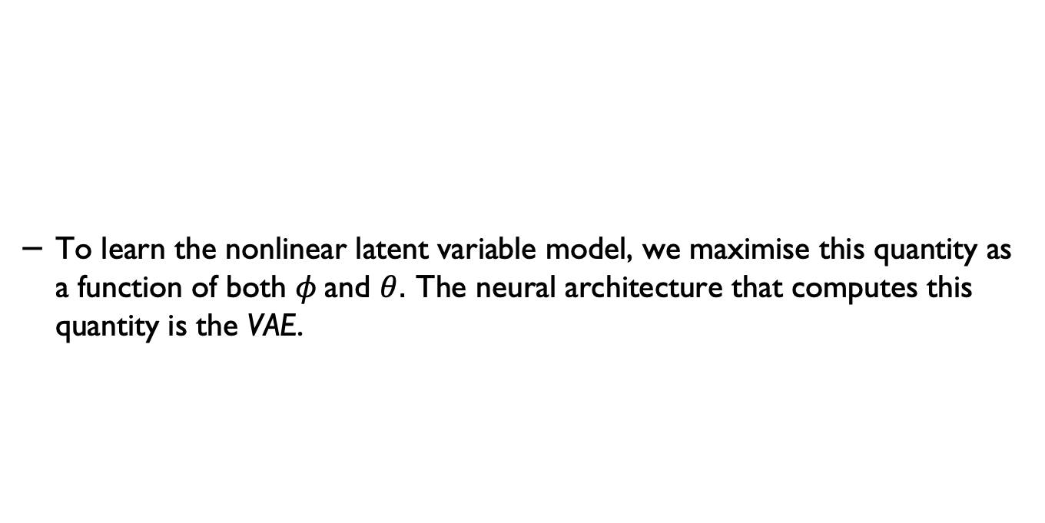
ELBO*
To learn the nonlinear latent variable model, we maximise this quantity as a function of both $φ$and $θ$. The neural architecture that computes this quantity is the VAE.

Slide 16
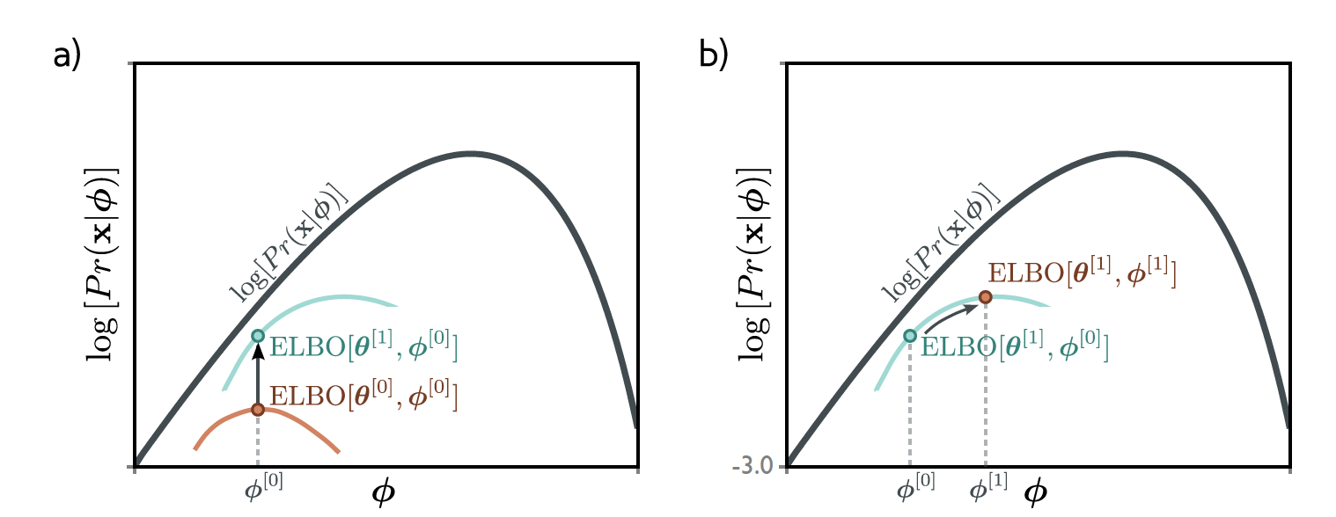
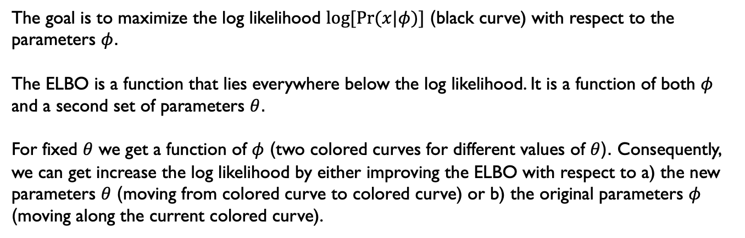
ELBO
The goal is to maximize the log likelihood $log⁡[Pr⁡(x|φ)]$ (black curve) with respect to the parameters $φ$.
The ELBO is a function that lies everywhere below the log likelihood. It is a function of both $φ$ and a second set of parameters $θ$.
For fixed $θ$ we get a function of $φ$ (two colored curves for different values of $θ$). Consequently, we can get increase the log likelihood by either improving the ELBO with respect to a) the new parameters $θ$ (moving from colored curve to colored curve) or b) the original parameters $φ$ (moving along the current colored curve).

Slide 17
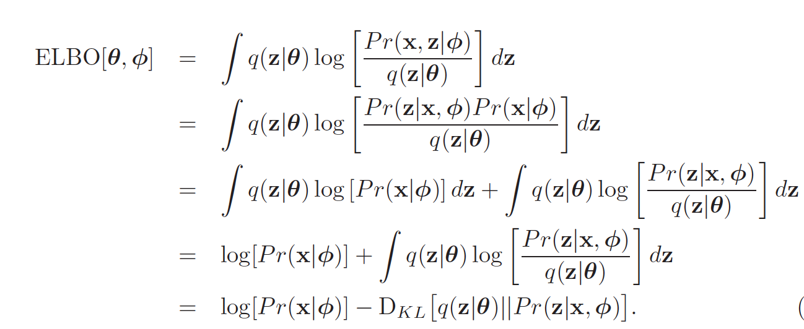
Determining the ELBO**

Slide 18
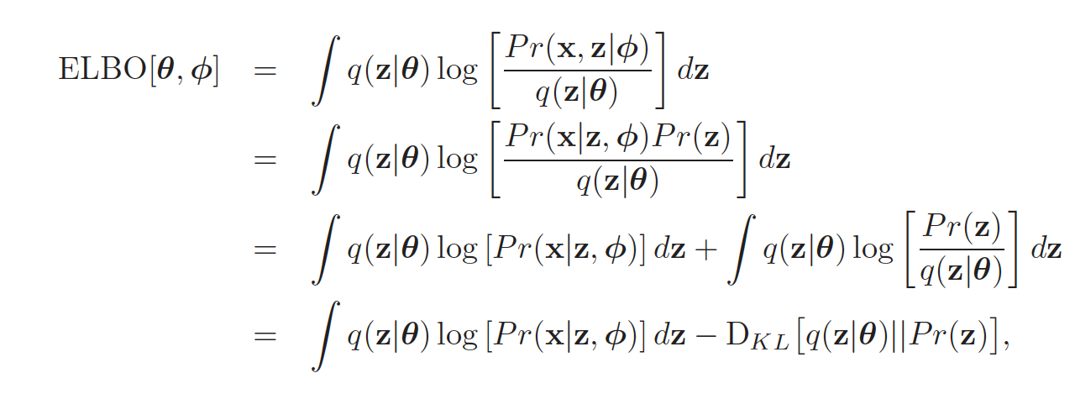
ELBO as reconstruction loss minus KL distance to prior*

Slide 19
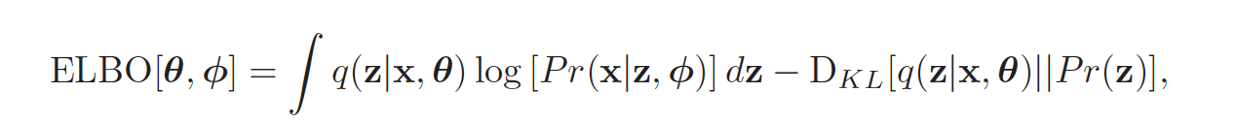
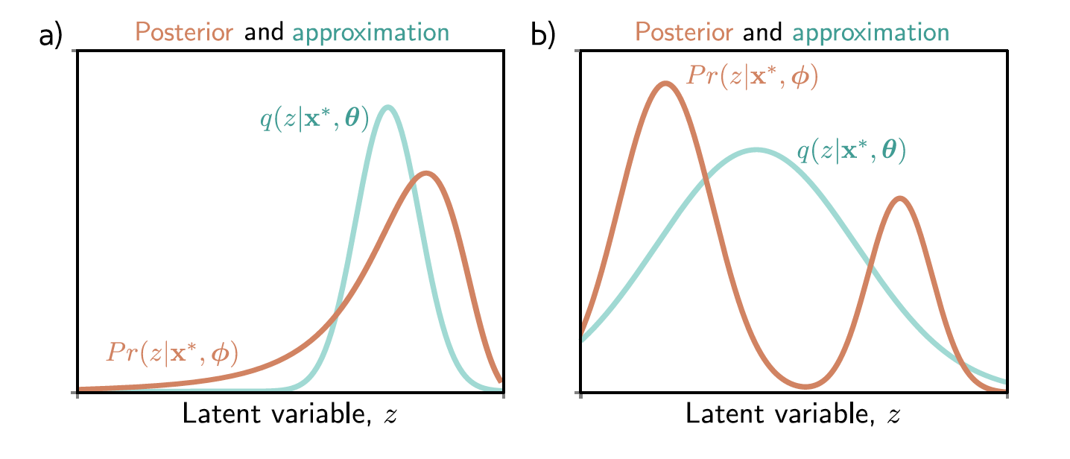
The variational autoencoder
Understanding Deep Learning, Simon J.D. Prince, MIT Press.

Slide 20
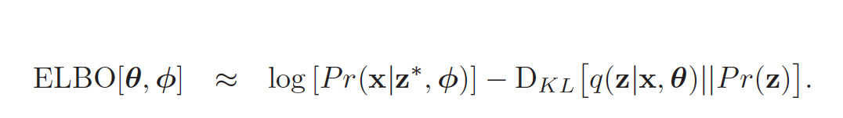
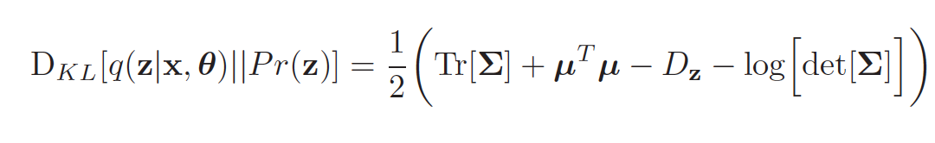
VAE
Understanding Deep Learning, Simon J.D. Prince, MIT Press.

Slide 21
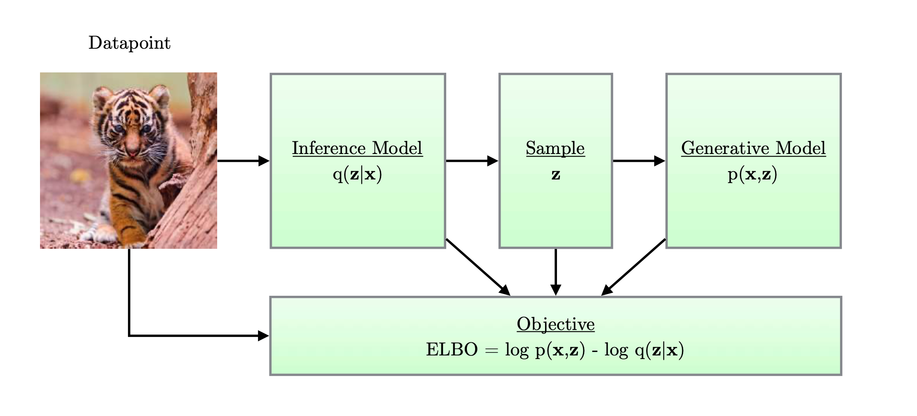
A simple schematic of a variational autoencoder
Diederik P. Kingma, Max Welling, An Introduction to Variational Autoencoders, Foundations and Trends in Machine Learning: Vol. 12 (2019): No. 4, pp 307-392.

Slide 22
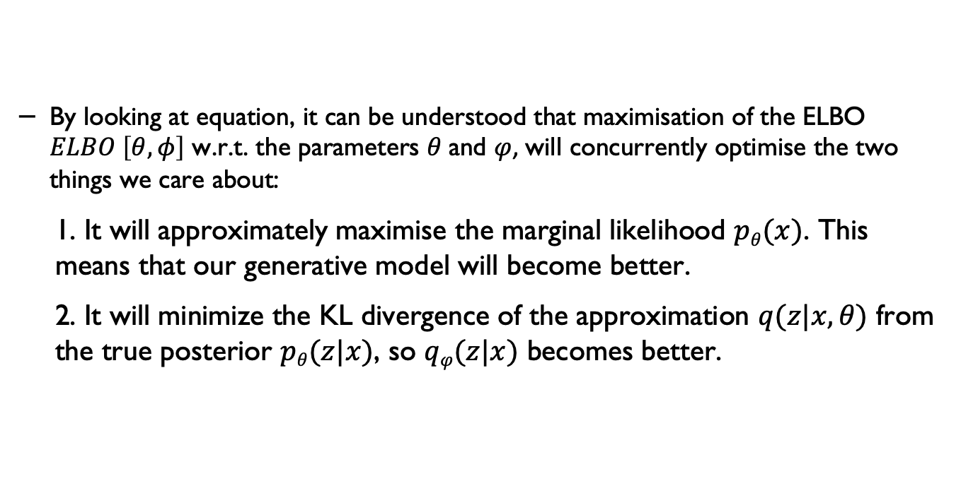
Variational lower bound
By looking at equation, it can be understood that maximisation of the ELBO $ELBO \left[θ, φ\right]$ w.r.t. the parameters $θ$and $φ$, will concurrently optimise the two things we care about:
1. It will approximately maximise the marginal likelihood $pθ(x)$. This means that our generative model will become better.
2. It will minimize the KL divergence of the approximation $q(z|x, θ)$ from the true posterior $pθ(z|x)$, so $qφ(z|x)$ becomes better.

Slide 23
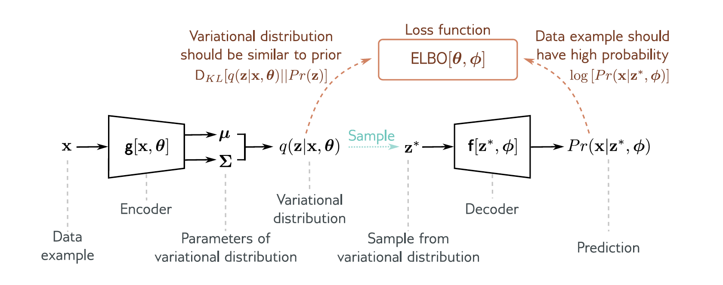
VAE
Understanding Deep Learning, Simon J.D. Prince, MIT Press.

Slide 24
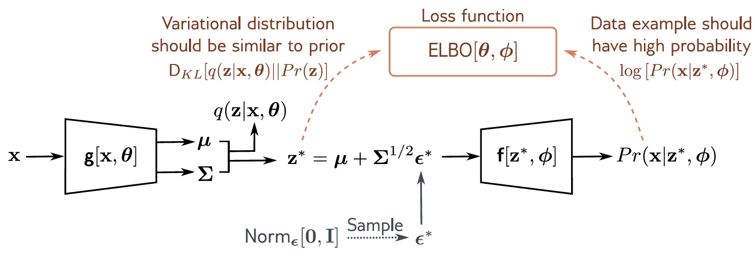
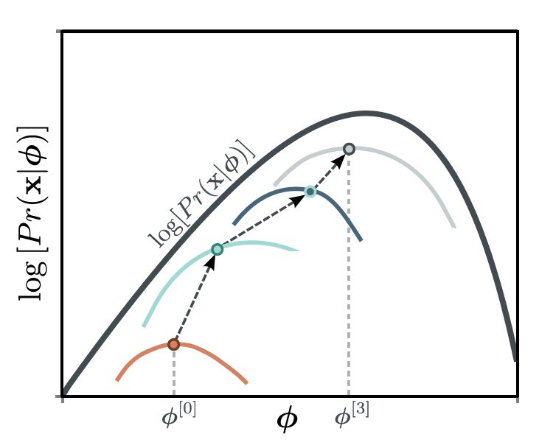
VAE – Reparameterisation trick
Understanding Deep Learning, Simon J.D. Prince, MIT Press.

Slide 25
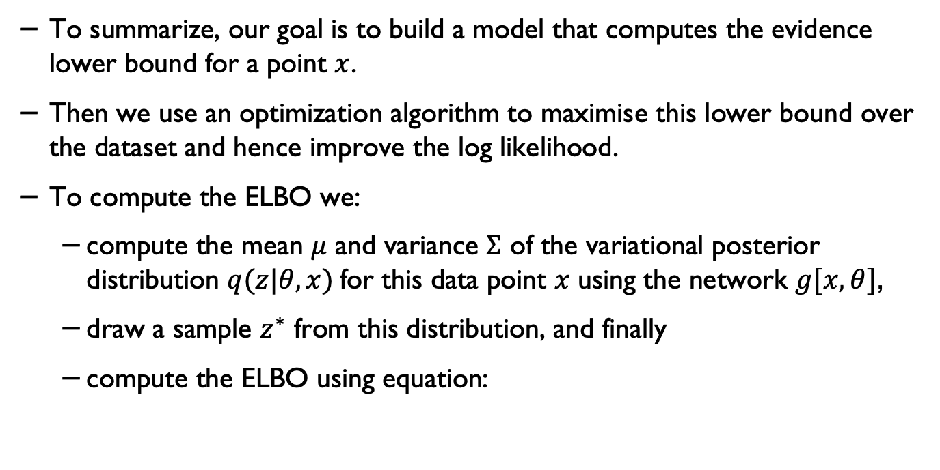
VAE algorithm
To summarize, our goal is to build a model that computes the evidence lower bound for a point $x$.
Then we use an optimization algorithm to maximise this lower bound over the dataset and hence improve the log likelihood.
To compute the ELBO we:
compute the mean $μ$ and variance $Σ$ of the variational posterior distribution $q(z|θ, x)$for this data point $x$ using the network $g[x, θ]$,
draw a sample $z^{∗}$ from this distribution, and finally
compute the ELBO using equation:

Slide 26
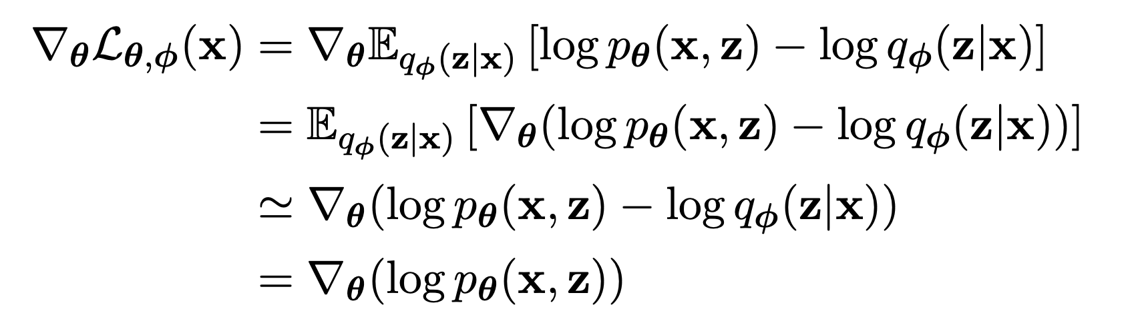
Stochastic Gradient-Based Optimization of the ELBO*
An important property of the ELBO, is that it allows joint optimization w.r.t. all parameters (φ and θ) using stochastic gradient descent (SGD).
We can start out with random initial values of φ and θ, and stochastically optimize their values until convergence.
Unbiased gradients of the ELBO w.r.t. the generative model parameters θ are simple to obtain:
Diederik P. Kingma, Max Welling, An Introduction to Variational Autoencoders, Foundations and Trends in Machine Learning: Vol. 12 (2019): No. 4, pp 307-392.

Slide 27
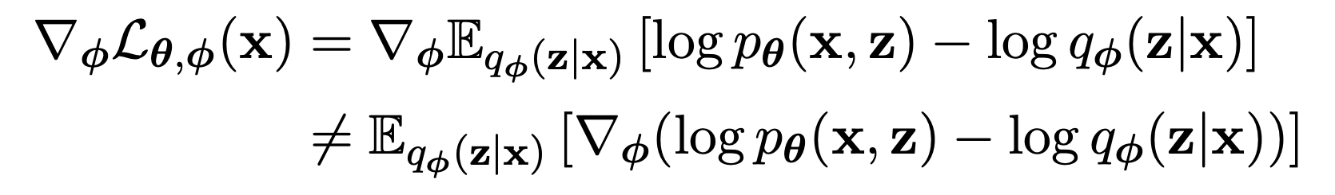
Stochastic Gradient-Based Optimization of the ELBO
Unbiased gradients w.r.t. the variational parameters φ are more difficult to obtain.
Since the ELBO’s expectation is taken w.r.t. the distribution q_{φ}(z|x), which is a function of φ. i.e., in general:
Diederik P. Kingma, Max Welling, An Introduction to Variational Autoencoders, Foundations and Trends in Machine Learning: Vol. 12 (2019): No. 4, pp 307-392.

Slide 28
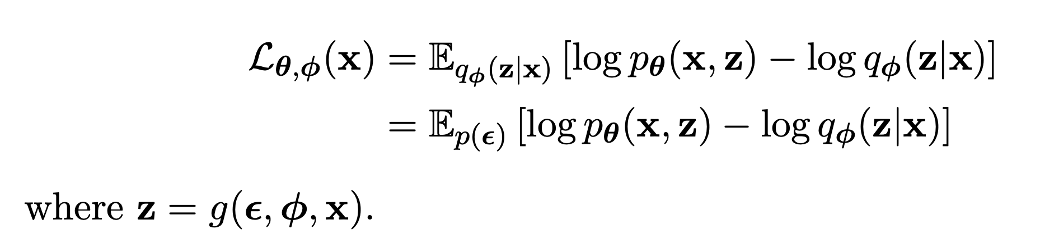
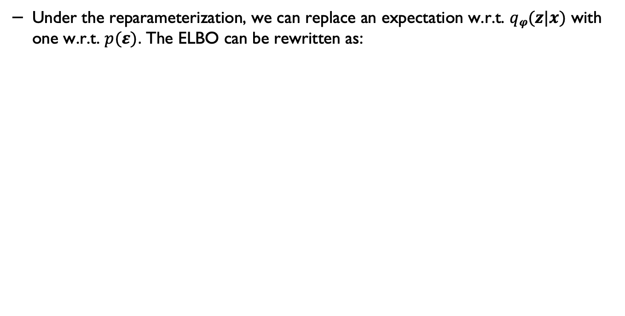
Gradient of ELBO
Under the reparameterization, we can replace an expectation w.r.t. $qφ(z|x)$ with one w.r.t. $p(ε)$. The ELBO can be rewritten as:
Diederik P. Kingma, Max Welling, An Introduction to Variational Autoencoders, Foundations and Trends in Machine Learning: Vol. 12 (2019): No. 4, pp 307-392.

Slide 29
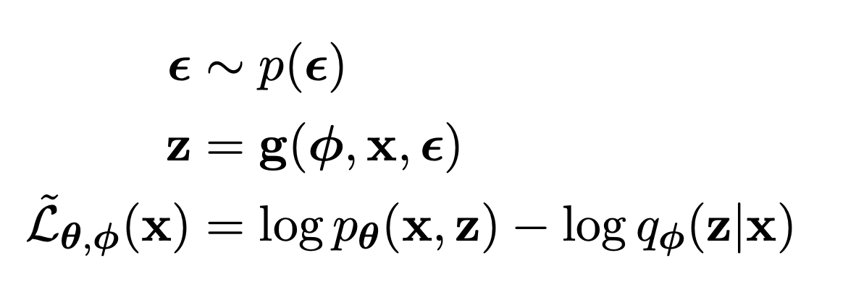
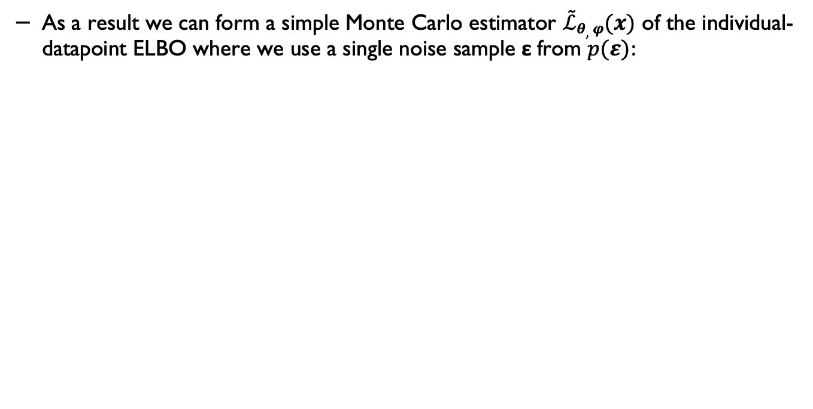
Gradient of ELBO
As a result we can form a simple Monte Carlo estimator $\tilde{ℒ}θ,φ(x)$ of the individual-datapoint ELBO where we use a single noise sample ε from $p(ε)$:
Diederik P. Kingma, Max Welling, An Introduction to Variational Autoencoders, Foundations and Trends in Machine Learning: Vol. 12 (2019): No. 4, pp 307-392.

Slide 30
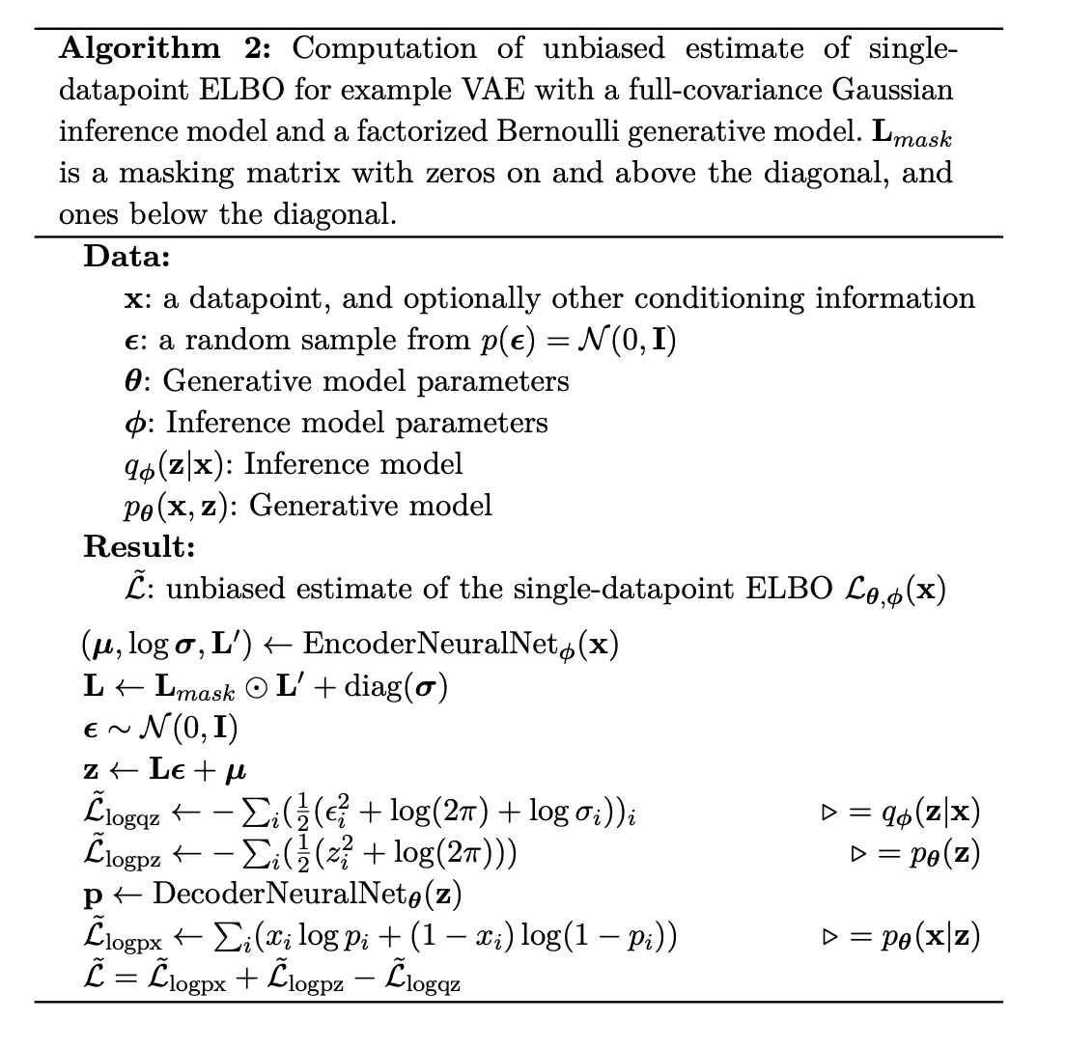
The ELBO algorithm
Diederik P. Kingma, Max Welling, An Introduction to Variational Autoencoders, Foundations and Trends in Machine Learning: Vol. 12 (2019): No. 4, pp 307-392.

Slide 31
Pytorch example
(adapted from: Minsu Kang, https://github.com/Jackson-Kang/Pytorch-VAE-tutorial/)

Slide 32

Pytorch libraries

Slide 33

Hyperparameters

Slide 34

Load MNIST

Slide 35

Defining the encoder

Slide 36

The decoder

Slide 37

The NN model

Slide 38

Encoder + Decoder

Slide 39



Loss function

Slide 40

Generating samples using the model

Slide 41


Sample input (left) and reconstruction (right)

Slide 42

Generating samples from noise

Slide 43
Acknowledgements
The main content are adapted from: Chapter 17, Understanding Deep Learning, Simon J.D. Prince, to be published by MIT Press.

Slide 44
If you have any questions
Please feel free to come and see me (9th Floor, Sir Michael Uren Research Hub, White City Campus) or email (p.barnaghi@imperial.ac.uk).

